Slide 1
Woodside TPO
Initial findings

Slide 2
TPO in review
Overview
Key Findings
Key Recommendations
Implementation Activities

Slide 3


Major Goals of a TCoE
Repeatable
Enable without hampering
Empower, measure and govern
Transform organisational knowledge, skills and capabilities
Create accelerators
Enable tools and technology
Continuous improvement
Increase quality
Consistent test relationship
Reliable
Auditable
Efficient
Scalable

Slide 4



Tools
Process
People
Notes:
Make bigger

Slide 5

The TPO in numbers
40
People interviewed
250+
Years of Woodside experience
50+
Artefacts Reviewed

Slide 6
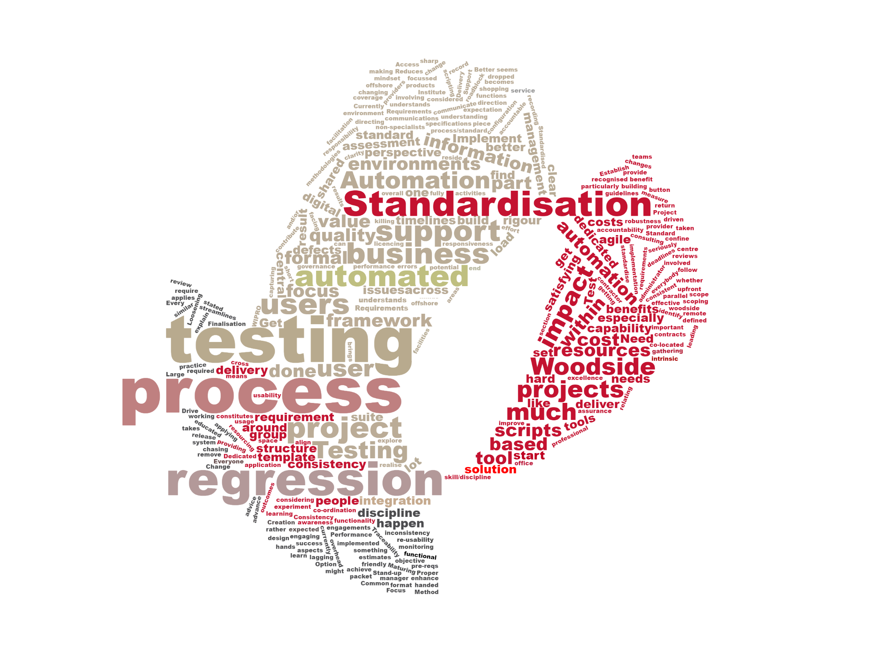
The TPO in your words

Slide 7

TPO Criterion
Reporting
Metrics
Test Function & Training
Test Automation
Office Environment
Test Specification Techniques
Testware Management
Test Process Management
Communication
Estimation & Planning
Test Environment
TPO
Test Strategy
Evaluation
Moment of Involvement
Defect
Management
Scope of Methodology
Life Cycle Model
Commitment & motivation
Low level Testing
Notes:
Standard colours

Slide 8
Summary of key TPO findings
Reliance on people over process
Siloed projects with lack of cross portfolio view
Lack of centralised test practice, framework and operating model
Testing is considered a final phase rather than a continuous activity. Value of testing not realised.
Undefined defect management process

Slide 9
Summary of key TPO findings
No standard test artefacts
No consistent approach to test estimation, planning and scope creep
No test automation framework or strategy
Inconsistent knowledge and skill base relating to testing and the test process
No consistent approach for performance and load testing

Slide 10
Summary of key TPO findings
No consistent approach for regression testing creation and execution
Inconsistent project governance and testing risk assessment approach
No common testing metrics and reporting
No consistent traceability between test artefacts and requirements
Project testing assets not re-used or maintained after go-live

Slide 11
Key Recommendations
Introduction of centralised testing champions
Siloed projects with lack of cross portfolio view
Bi-Modal test framework
Lack of centralised test practice, operating model and integration with existing change management process.
Test management process
Undefined defect management process
Inconsistent knowledge and skill base relating to testing and the test process
No standard test artefacts
No consistent approach to test estimation and planning
Inconsistent project governance based on testing risk decisions
No consistent traceability between test artefacts and requirements
Testing engaged to late in life cycle
Reliance on people over process
No centralised testing practice or knowledge
No consistent use of test management and reporting toolsets
No consistent measurement of quality throughout the product delivery lifecycle

Slide 12
Key Recommendations
Test Automation and Performance model
Regression Testing Approach
Establish Continuous Improvement driven via testing metrics
No common testing metrics and reporting
No test automation framework or strategy
No consistent approach for performance and load testing
Project testing assets not re-used or maintained after go-live
No consistent approach for regression testing creation and execution
Value of testing not quantified

Slide 13
Implementation Activities
Introduction of centralised testing champions
Create Bi-Modal test framework
Establish test management process
Approach
Create competency to devolve knowledge and responsibilities to delivery teams/product owners
Establish key knowledge/training requirements for testing
Coaching other resources
Define CoE roles and responsibilities
Centralised testing service contact (cross portfolio)
Drive strategic / cultural change
Support project delivery
Establish common language of testing
Engagement of line of business representatives to understood business and operation needs
Approach
Creating set of minimum standards to support Agile and Waterfall delivery
Standard templates to avoid rework
Align to existing UCP / HOTS process
Testing against business needs and risk appetite
Define test estimation and planning model
Testing delivery responsibilities
Identify pilot projects for implementation of framework
Approach
Drive use of common Test Management tool(s)
Create defect management process
Ensure traceability from tests to business needs (requirements)
Establish minimum standards and classifications for test cases / defects
Embed testing as a process not an end-of-project phase.
Establish facility to drive performance change across Woodside and technology partners.

Slide 14
Implementation Activities
Test Automation and
Performance model
Regression Testing Approach
Establish Continuous Improvement driven via testing metrics
Approach
Guidance on when and how to Performance test based on change risk and application classification
Review and evaluation of all automation and performance plans/results produced by Woodside partners.
Establishing automation co-ordination and evaluation capabilities to ensure tooling decisions, approaches and implementations are appropriate and drive business value
Approach
Identifying, standardising and optimising key regression test suites for critical apps.
Creation of maintenance model for regression testing assets.
Where applicable, co-ordinating the implementation of automation for regression test suites.
Monitoring and reporting on the re-use, defect detection rate and efficiency of regression test suites.
Approach
Establish KPI for testing / quality
Establish common reporting framework and dash boarding
Monitor quality of deliverables across delivery lifecycle
Understand quality across portfolio and suppliers
Metrics will help drive CI process

Slide 15

Competency & Maturity
6 - Establish Continuous Improvement driven via quality KPIs
COST
5 - Reporting Standardisation
Low
Medium
High
COMPLEXITTY
4 - Define and deliver test automation and performance model
Decentralised testing service capability delivered via Woodside CoE
Low
Medium
High
3 - Establish and embed Test management process and tooling (ALM/JIRA)
2 - Create and implement Bi-Modal test framework
1- Introduction of centralised TMO
Competency

Slide 16
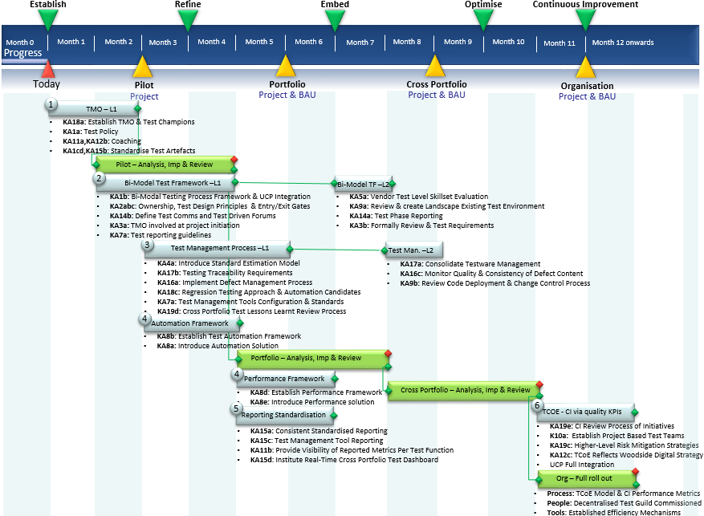

Slide 17
Your Feedback is Welcome
Jason Stannage: 0414 487 051 jstannage@planittesting.com

